Slide 1
BIA 650 – Process Optimization and Analytics
OPL - CPLEX
Introduction to tools
Simple Production Problem
  Arrays
  Data Declarations
  Generalized Problem
© E. A. Stohr, 2018
Notes:
This course is about designing organizations and processes.
Processes are the means through which work gets done. (Good people can’t overcome poor processes (Peter Keen)
Often the design approach will involve the use of IT. But people are just as important. We will try to take a balanced view.
How do we know if an organization is more efficient? More effective?
(Both efficiency & effectiveness are important, but many “efficient” organizations are now out of business.
In this lecture, we concentrate on how we can measure the efficiency (productivity) of organizations and processes. Unless we can measure improvement, we can not tell if our design intervention has been useful.
Three approaches to answering this question:
Economist’s - Data Envelopment Analysis
Accountant’s - Activity-based Costing (ABC)
Financial - ROI and Economic Value added (EVA)

Slide 2
IBM ILOG OPL Components
OPL Optimization Programming Language: A simple modeling language for optimization
CPLEX: A powerful solver for large-scale LP/IP, MIP, etc.
CPLEX Studio IDE*: User-friendly interface for the CPLEX solver. Edit models, display results, and so on.
Software is free for students:
https://www.ibm.com/account/reg/us-en/signup?formid=urx-20028
* IDE – Integrated Development Environment

Slide 3
Simple Example
Consider a Belgian company Volsay, which specializes in producing ammoniac gas (NH3) and ammonium chloride (NH4Cl). Volsay has at its disposal 50 units of nitrogen (N), 180 units of hydrogen (H), and 40 units of chlorine (Cl). The company makes a profit of 40 Euros for each sale of an ammoniac gas unit and 50 Euros for each sale of an ammonium chloride unit. Volsay would like a production plan maximizing its profits given its available stocks.
The OPL statement shown below formalizes this problem.
Source: https://www.ibm.com/support/knowledgecenter/SSSA5P_12.6.1/ilog.odms.ide.help/OPL_Studio/opllanguser/topics/opl_languser_shortTour_LP_elements.html

Slide 4
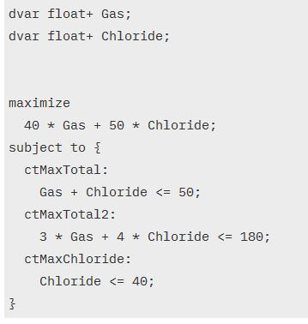
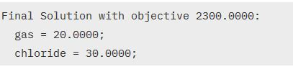
Volsay Production Problem (ctd.)

Slide 5
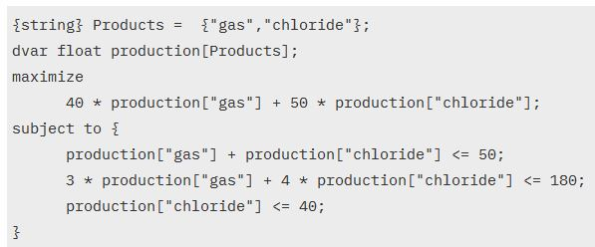
Volsay: Using Arrays

Slide 6
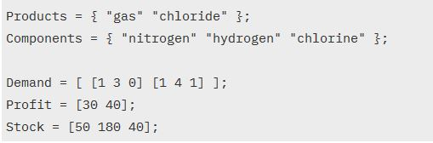
VOLSAY: Data Declarations

Slide 7
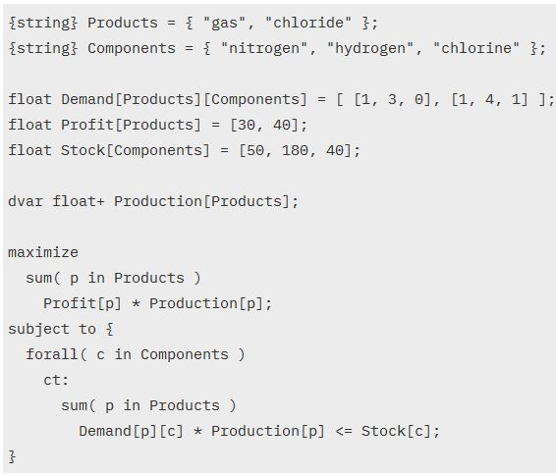
Volsay: Generalized Model

